Slide 1

Trending YouTube Video Statistics Data-set
Oyinda Omole

Slide 2
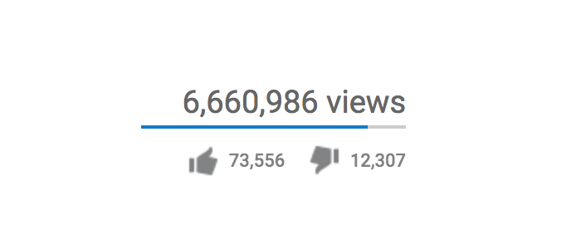
‘Exploring the factors that influence YouTube video views through feature analysis and prediction’

Slide 3

Introduction
Problem definition:
Data Science Question: ‘Can we predict the number of views a YouTube video will generate?’
Business Question: ‘What common features do trending YouTube videos share? What influence do they have over the number of views?’
Why is this beneficial
Content strategy
Resource allocation
Audience engagement
Monetization and revenue
Performance evaluation

Slide 4
Cleaning steps and Final columns
Removed single digits from text columns.
Removed hyperlinks from text columns.
Broken down date columns into Year, Month, Day.
Removed special text from date columns.
Created a new column for the Category id titles.
Final data frame columns: 'video_id', 'title', 'channel_title', 'category_id’,'views', 'likes', 'dislikes', 'comment_count’, 'description_no_num_links', 'tags_clean', 'trending_date_month', 'trending_date_day', 'trending_date_year', 'publish_time_month', 'publish_time_day', 'publish_time_year', 'category_id_title'],

Slide 5


Data Collection
The ‘Trending YouTube Statistics’ dataset is from Kaggle
The quality of datasets varies. However, datasets are ranked according to usability which helps to assess data quality.
- 7.5
How was this dataset collected?
This dataset was web scraped using an API that collected data directly from the YouTube website daily .:
This dataset contains recent data about trending videos. An older dataset may not contain data that is useful in predicting the features that are currently relevant.

Slide 6

Data Description
What does this data contain?
Daily trending YouTube videos with over 6 months of data: Russia, Mexico, South Korea, Japan and India
Columns:
Data includes the: 'video_id', 'trending_date', 'title', 'channel_title', 'category_id',
'publish_time', 'tags', 'views', 'likes', 'dislikes', 'comment_count',
'thumbnail_link', 'comments_disabled', 'ratings_disabled',
'video_error_or_removed', 'description'
Each row contains a video entry for each individual video
Target:
Views: The number of people who have watched a specific YouTube video.

Slide 7
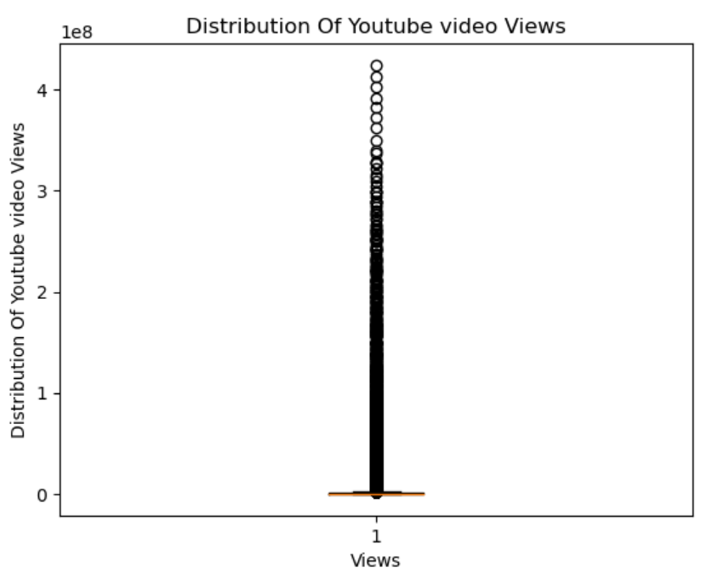
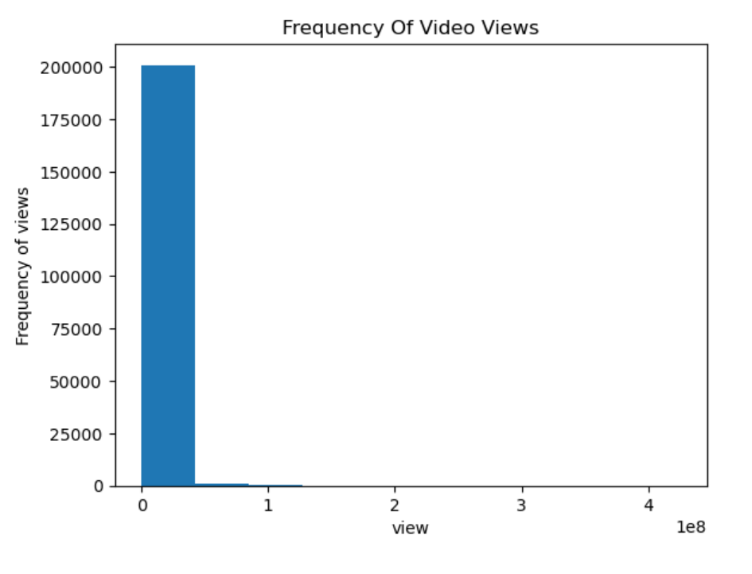
Target Variable Visualisations
The above boxplot for the distribution of views shows that the dataset is filled with outlier values.
Due to the nature of the dataset (Trending YouTube videos) there are only entries about YouTube videos that are considered anomalies because their number of views deviates from most of the data.
- The histogram presents a right skewed distribution - positively skewed (fewer datapoints with larger values)

Slide 8
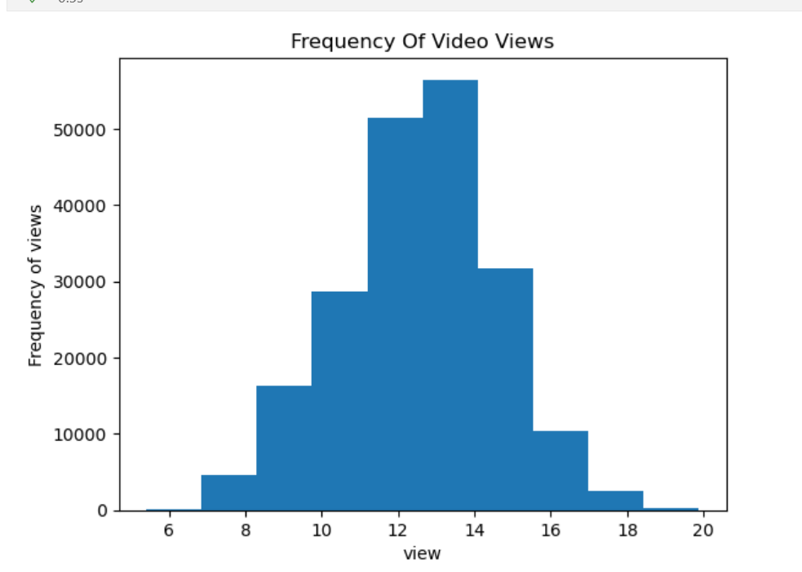
Log transformation
- Larger values are compressed more than smaller values, bringing the distribution closer to a normal distribution. Log transformation changes the scale of the data and transforms every value to its logarithmic value.
- np.log1p was used instead of np.log. This because this dataset is full of 0s, the normal log function does not work on 0s because the logarithm of 0 is undefined. np.log1 adds a 1 to the 0s so that the log transformation can be done (a constant value)

Slide 9
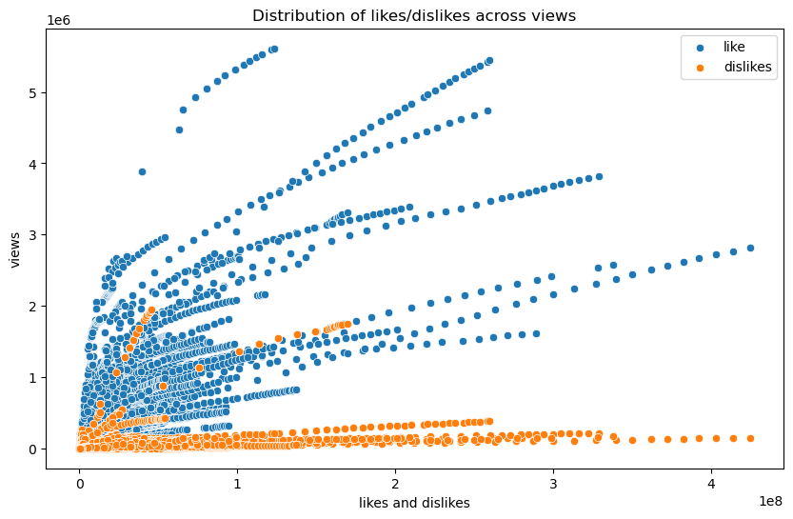
Plotting likes and dislikes

Slide 10
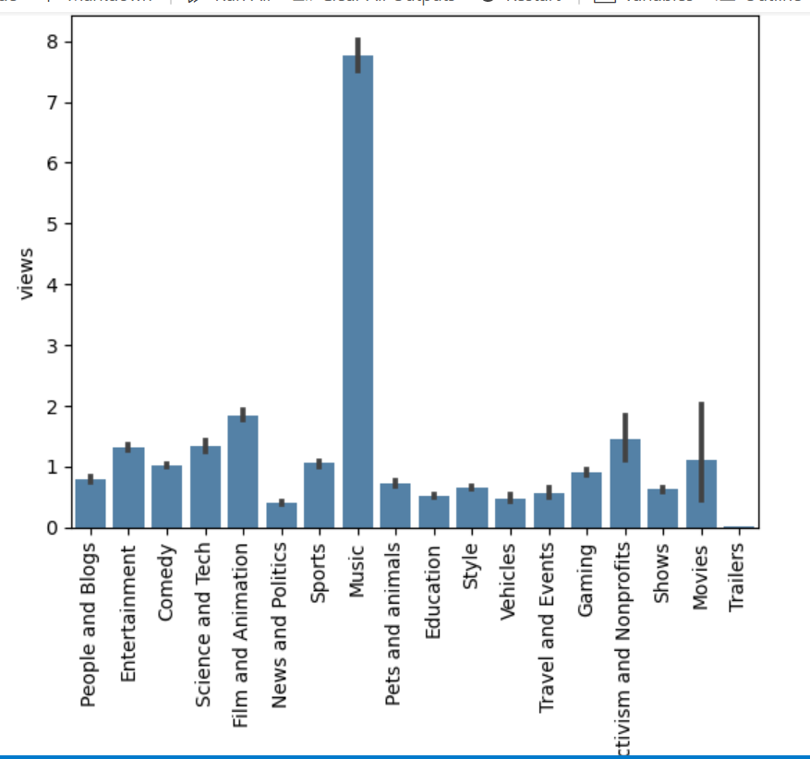
Category titles

Slide 11
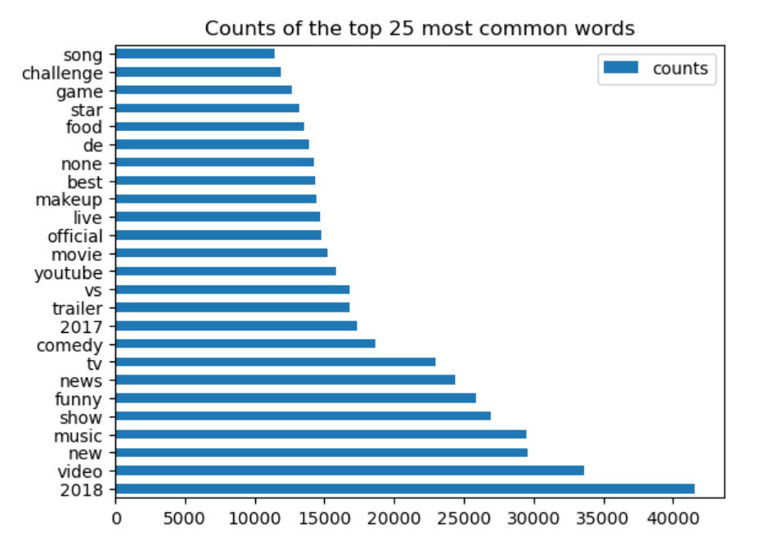
Most common words – Tags column

Slide 12
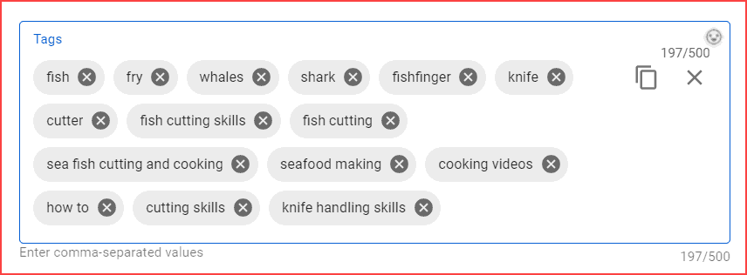
Models
Models:
Linear Regression
Lasso Regression
Ridge Regression
Gradient Boosting Regression
XGBoost Regression

Slide 13
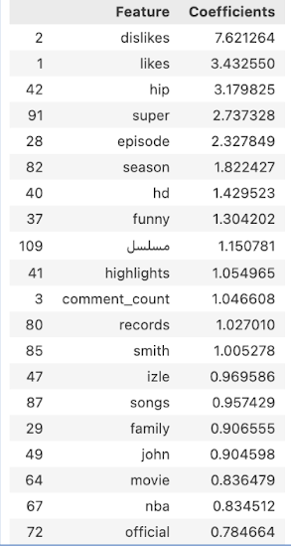
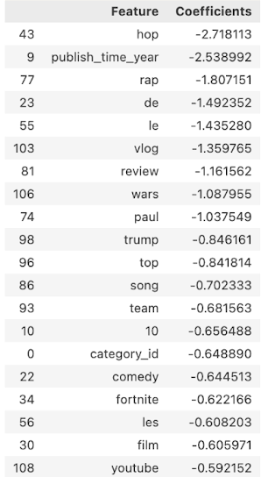
Linear Regression model

